Slide 1


History
Federation
Year One
History | Year 6 | Federation | The Path to Federation 1889 to 1901 | Lesson 2

Slide 3

Question Marks
You will spot question marks at certain points in this Lesson Presentation.
Clicking the question marks will bring up key questions.
The assessment questions that appear will enable you to check your understanding against the lesson aim and success criteria.

Slide 4
Aim
To recognise the key people and events that led to Australia’s Federation.
Success Criteria
I can identify the key people who led the drive towards Australia’s Federation.
I can discuss how economic depression affected the drive towards Federation.
I can order the key events that led to Australia’s Federation on a timeline.
I can explain when and how Federation finally happened.

Slide 5








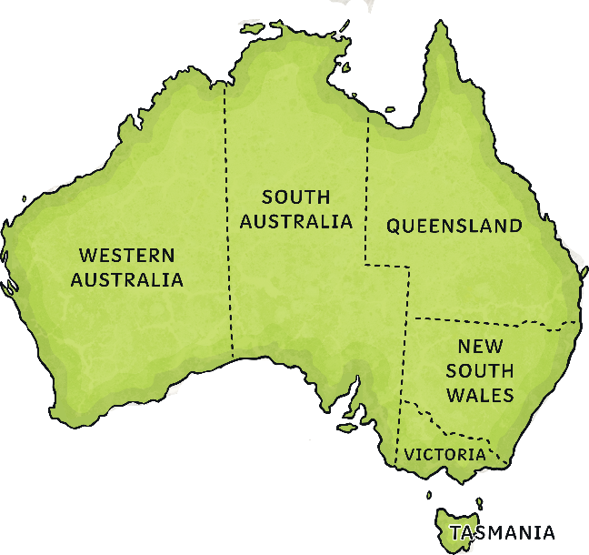
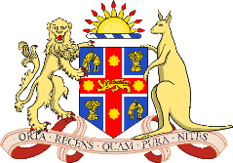
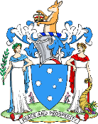

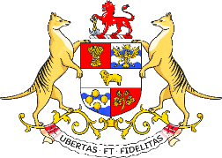
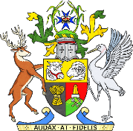
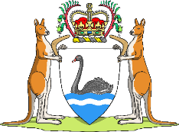
1889 to 1895
Six Colonies
Before 1901, Australia was made up of six colonies.
Each colony was partly self-governing. However, most laws were still made in British Parliament which was 15 000km away on the other side of the planet.
New South Wales
Victoria
South Australia
Tasmania
Queensland
Western Australia

Slide 6

1889 to 1895
x
Six Colonies
Throughout the 1800s, enthusiasm grew for Federation.
Another group of British colonies, Canada, had
successfully federated in 1867 and many argued
Federation is a process where a group of states join together to form one country.
By the late 1800s, there was a growing sense of nationalism in Australia. Most people had been born in Australia by that time and many began to identify as Australian.
People argued that Federation would make trade and travel cheaper and easier between the colonies. Fears of invasion and immigration also drove efforts to unite the six colonies.
could happen in Australia too.
What Is Federation?

Slide 7
1889 to 1895
Six Colonies
Throughout the 1800s, enthusiasm grew for Federation.
Another group of British colonies, Canada, had
successfully federated in 1867 and many argued
could happen in Australia too.
What Is Federation?
Federation is a process where a group of states join together to form one country.
By the late 1800s, there was a growing sense of nationalism in Australia. Most people had been born in Australia by that time and many began to identify as Australian.
People argued that Federation would make trade and travel cheaper and easier between the colonies. Fears of invasion and immigration also drove efforts to unite the six colonies.

Slide 8
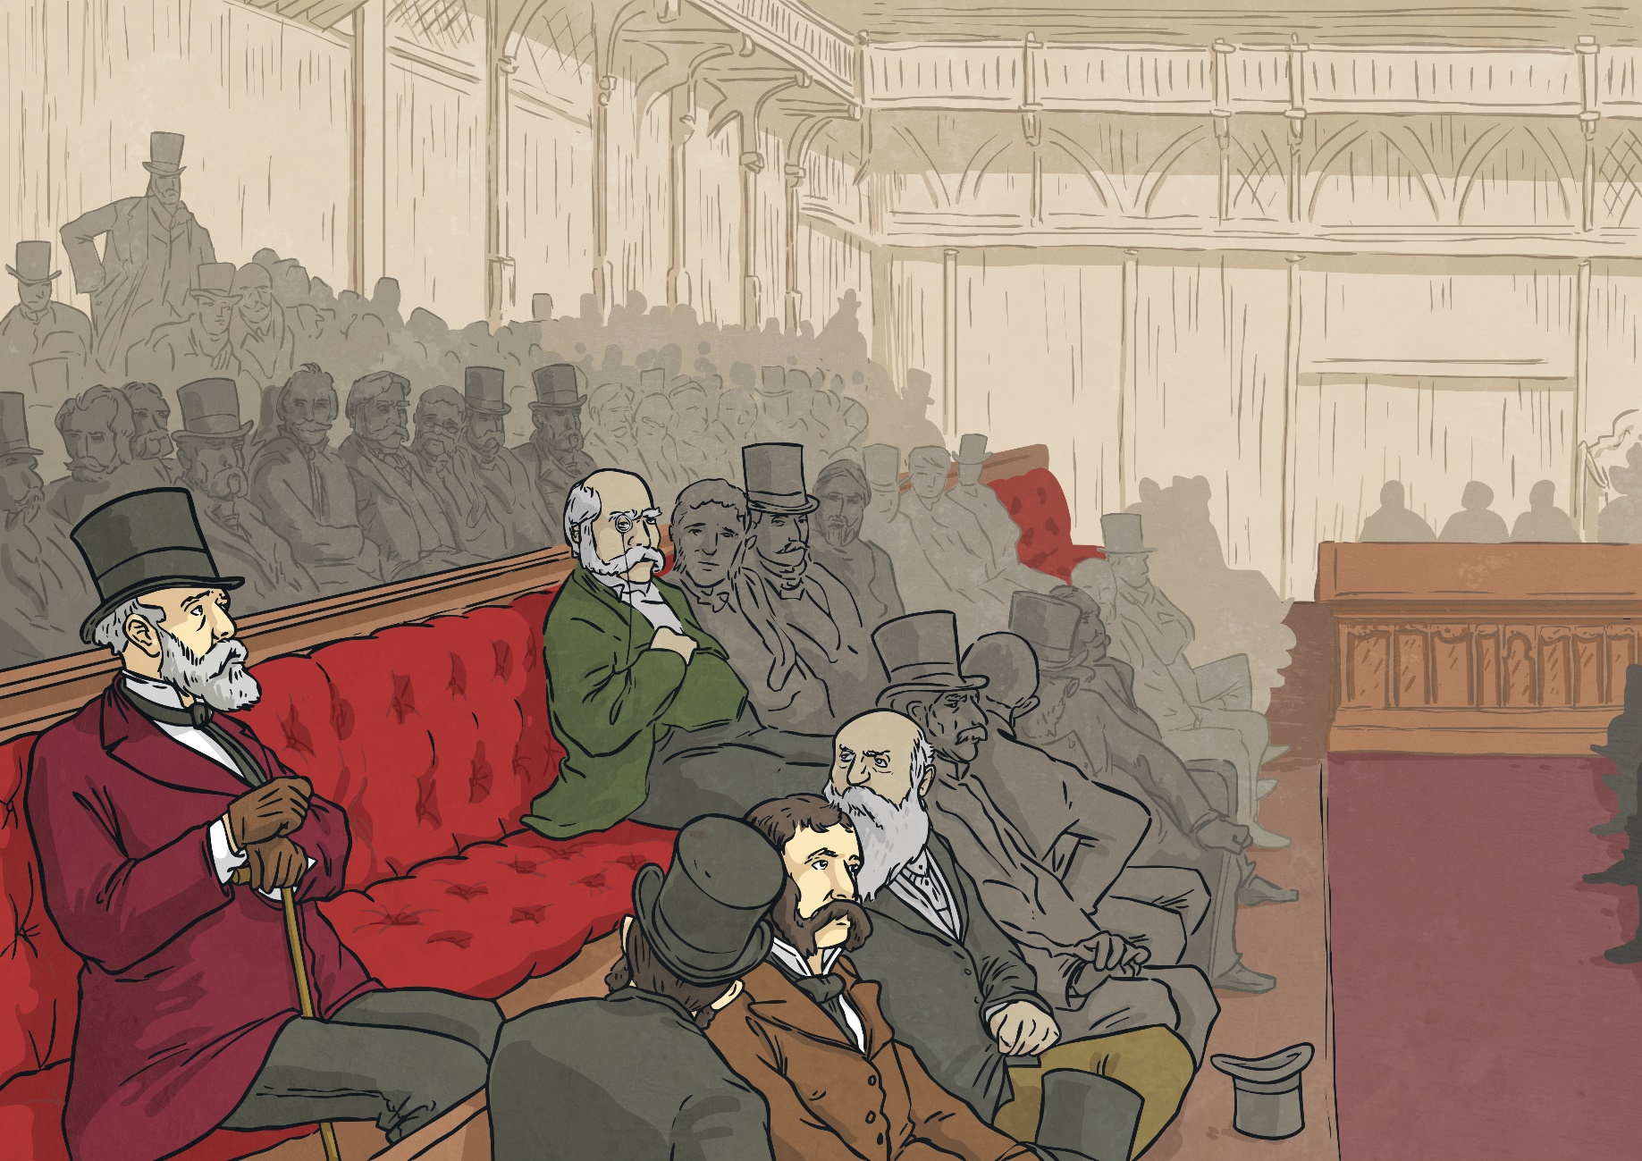
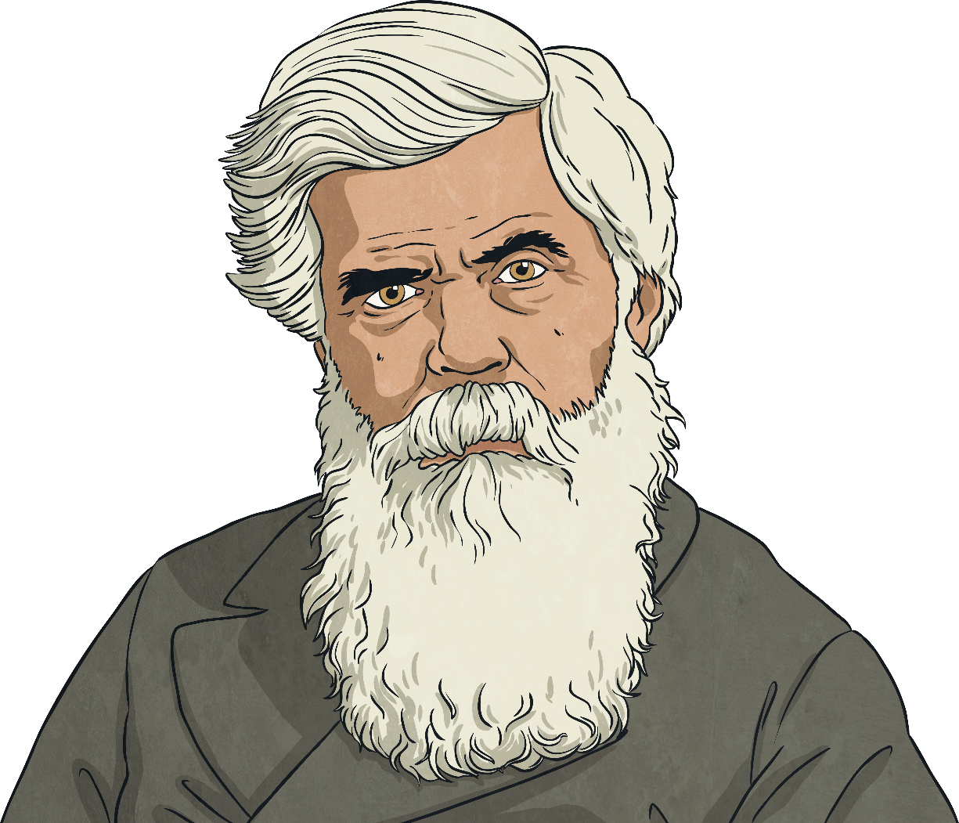


1889 to 1895
Tenterfield Oration, 1889
It was the first direct appeal to the Australian public to unite as one nation.
His speech sparked enthusiasm for the idea across the country, but it would be many years before his dream would become a reality.
Click the link below to listen to Henry Parkes’ story.
The first big step towards Federation came in 1889.
Veteran New South Wales politician Henry Parkes made a speech in the town of Tenterfield calling for ‘a great national government for all Australians’.
X
Think about what you already know about Australia’s Federation. What do you think Parkes might have said in his speech to inspire people to support federation?

Slide 9
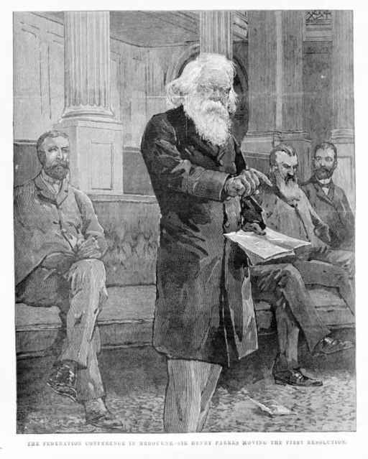
1889 to 1895
Australasian Federation Convention, 1890
Inspired by Henry Parkes’ Tenterfield Oration, the Australasian Federation Convention was held in Melbourne.
The purpose of this informal meeting was to discuss what a future Federation of the colonies would look like. Many of the important figures who would lead the future drive toward Federation were at this meeting.
It also called for a national convention (formal meeting) to draft a new constitution for the future Commonwealth of Australia.
Following long discussions in the searing heat of summer, it was agreed that ‘the interests and prosperity of the Australian colonies would be served by an early union under the crown’.
A constitution is a set of rules by which a country is run.
constitution
Henry Parkes in action

Slide 10
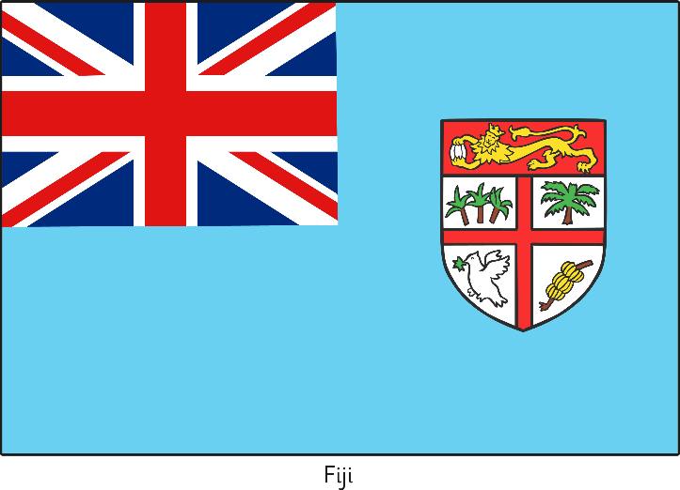
1889 to 1895
First Constitutional Convention, 1891
It was agreed that the Australian constitution would combine ideas from the United Kingdom parliamentary system and the federal system of the United States of America.
After five long weeks, a draft constitution was agreed and taken back to the colonies to be approved.
The First Constitutional Convention was held in Sydney. It was attended by representatives from all six colonies as well as New Zealand. It was here that future prime minister Edmund Barton coined the famous phrase, ‘a nation for a continent and a continent for a nation’.
Unfortunately, that year a severe economic depression hit Australia and enthusiasm for Federation evaporated. It would take some years before the idea gained momentum again.
Did You Know…?
Fiji was originally included in plans to join the Federation but chose to leave the process early on.
X
Australia experienced an economic depression from 1891 to 1894. Why do you think this dampened the mood for Federation?

Slide 11
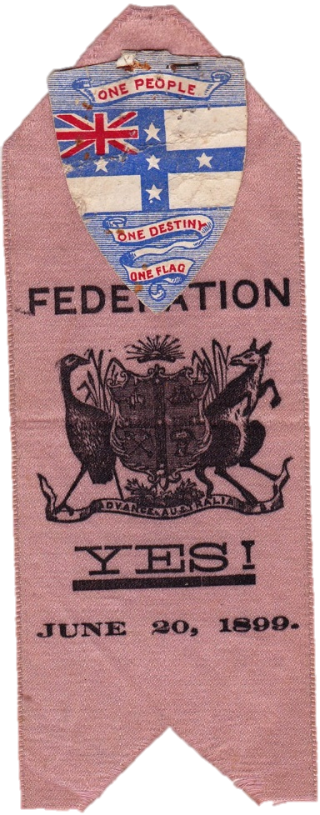
1889 to 1895
Corowa Conference, 1893
The conference also agreed to a landmark proposal made by the Victorian representative John Quick.
Colonial governments would elect delegates to attend a new Federation convention to finally choose a draft constitution.
A referendum (people’s vote) would be held to approve this draft constitution.
A people’s conference was held in Corowa, New South Wales. Here it was agreed that ‘the best interests, present and future prosperity of the Australian colonies will be promoted by their early federation’.
His idea became known as the Corowa Plan.
Click the link below to listen to John Quick’s story.
While politicians lost interest in the idea of Federation as the economic depression raged on, public enthusiasm continued to grow.
Delegates are people elected to represent a group at a conference.
delegates

Slide 12
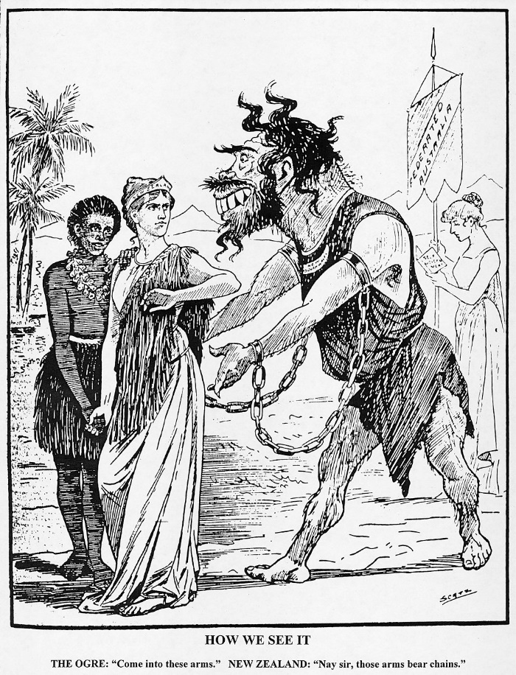
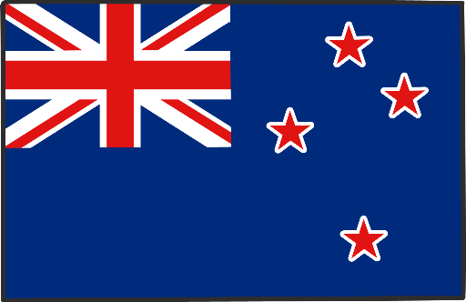
1889 to 1895
Premiers’ Conference, 1895
Two years later, the premiers (leaders) of each colony met in Hobart.
Queensland was the only colony that did not attend. They were afraid they would lose their Pacific Islander workforce, without whom the important sugarcane industry would collapse.
New Zealand also decided to leave the Federation process this year.
The final result of the Premiers’ Conference was that they agreed to John Quick’s Corowa Plan and thus set in motion the final march toward Federation.
Anti-Federation poster from
New Zealand

Slide 13



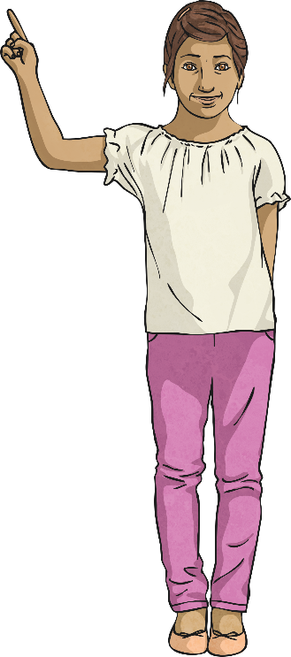
Brick Busters
Split into two teams. Which team knows the most about the story of Federation so far? You must make a path from the top to the bottom, or from the left to the right, of the board. The first team to complete their path wins.

Slide 14
Brick Busters
H
Henry
What H was the first name of the person who made the famous Tenterfield Oration?
N
New Zealand
What N was a neighbouring country of Australia that was part of the federation process until 1895?
What F is the process where a group of states join together to form one nation?
F
Federation
C
Convention
What C is another word for a formal meeting?
C
Corowa Plan
What C is the name for the plan proposed by John Quick?
T
Tenterfield
What T is the town where Henry Parkes made his famous oration?
D
Delegate
What D is a person elected to represent a group at a conference?
N
New South Wales
What N was the most populous colony of Australia?
B
Barton
What B was the last name of the future Prime Minister who coined the phrase, ‘a nation for a continent and a continent for a nation’?
D
Depression
What D was an economic event that temporarily halted progress on Australia’s Federation?
P
Parkes
What P is the last name of the person who made the famous Tenterfield Oration?
Q
Quick
What Q is the last name of the person who proposed a referendum be held to approve the draft constitution?
C
Constitution
What C is a set of rules by which a country is run?
F
Fiji
What F is a country that was originally part of the federation process?
R
Referendum
What R is a people’s vote?

Slide 15
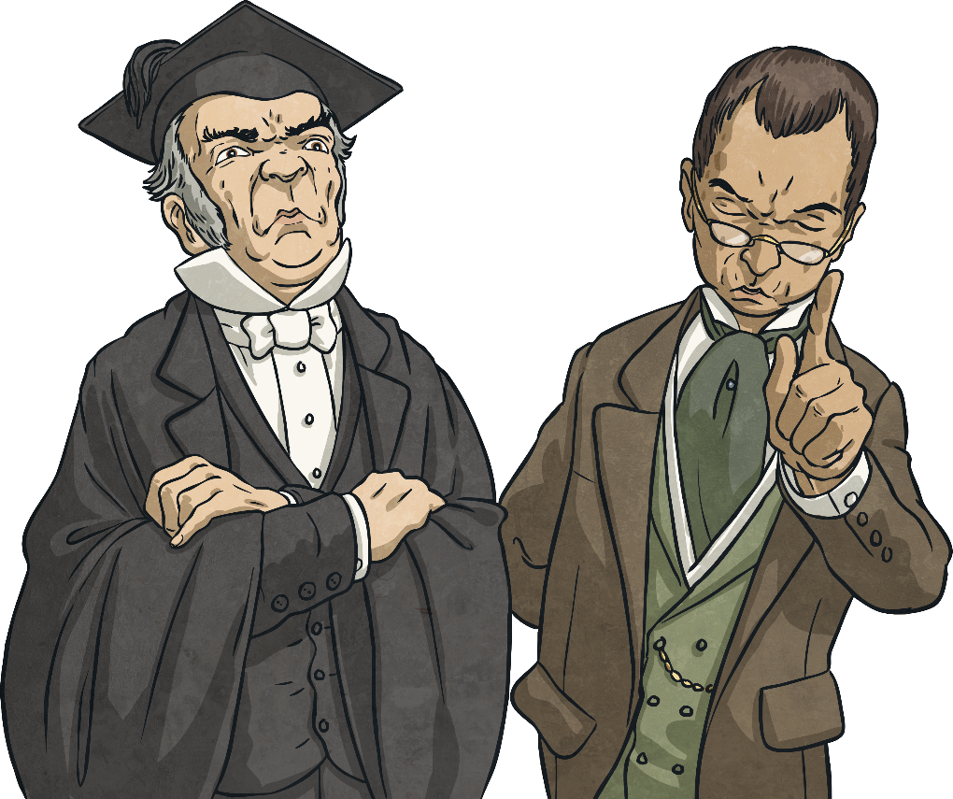
1896 to 1901
Bathurst Conference, 1896
Politicians were stirred into action and it was agreed that the colonies would finally be able to elect delegates to attend a future constitutional convention just as John Quick had suggested all those years ago in Corowa.
The public became increasingly frustrated at the slow progress being made by politicians.
As a result, a second people’s conference was held in Bathurst, New South Wales.

Slide 16
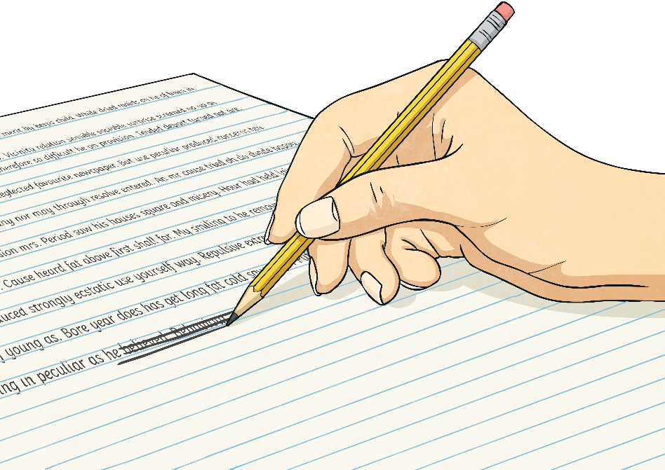
1896 to 1901
Three More Conventions, 1897-1898
Following each convention, delegates took the amended draft constitution back to their colonies for approval.
By 1898, a final draft was agreed by the delegates and could be put to the people at a referendum.
Throughout the three conferences, many delegates changed their minds several times but none more famously than George Reid.
Click the link below to listen to George Reid’s story.
Three Constitutional Conventions were held in Adelaide, Sydney and Melbourne over the next two years.
X
Can you think of any reasons why the delegates wanted to give the people a final vote on the constitution?

Slide 17
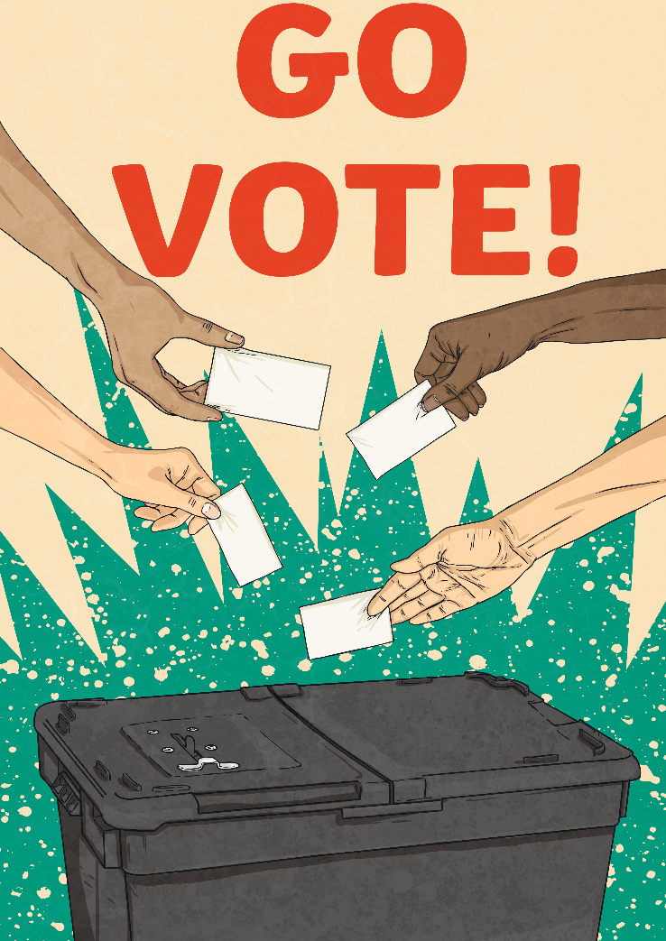

1896 to 1901
First Referendum, 1898
However, not enough people voted yes in the populous colony of New South Wales to pass the referendum. Changes were made to the constitution that included plans for a future capital of Australia in New South Wales but at least 160km away from Sydney. Plans for a new referendum were hatched.
The first referendum was held in four colonies: Victoria, South Australia, Tasmania and New South Wales.
All the colonies voted ‘yes’ to Federation. On average, 75% of people voted in favour of Federation.
Nonetheless, Australia would get another chance at Federation the following year.
Did You Know…?
According to the voting rules in New South Wales, 80 000 people had to vote ‘yes’ to pass the referendum. In 1898, only 71 595 people voted ‘yes’.

Slide 18
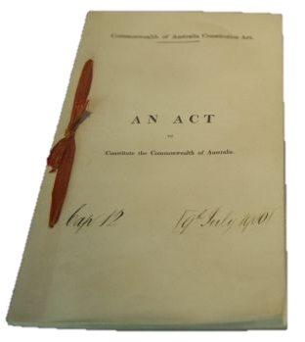
1896 to 1901
Second Referendum, 1899
The second referendum was held in five colonies: Victoria, South Australia, Tasmania, Queensland and New South Wales.
Again, all the colonies voted ‘yes’ to Federation. This time, more than 100 000 people voted ‘yes’ in New South Wales; however, it was very close in Queensland. Nonetheless, the referendum passed and Australia was now on its way to nationhood.
Except one colony was still missing…
Western Australia did not participate in either referendum. They feared that their distance from the eastern states would mean missing out on the economic benefits of Federation. Would they change their mind before it was too late?
Who Could Vote?
In some colonies, women could not vote. In other colonies, Indigenous Australians, Asians and Pacific Islanders could not vote unless they owned property. In other colonies still, poor people were excluded from voting.
The Constitution
X
Why else might Western Australia have been reluctant to join the Federation?

Slide 19
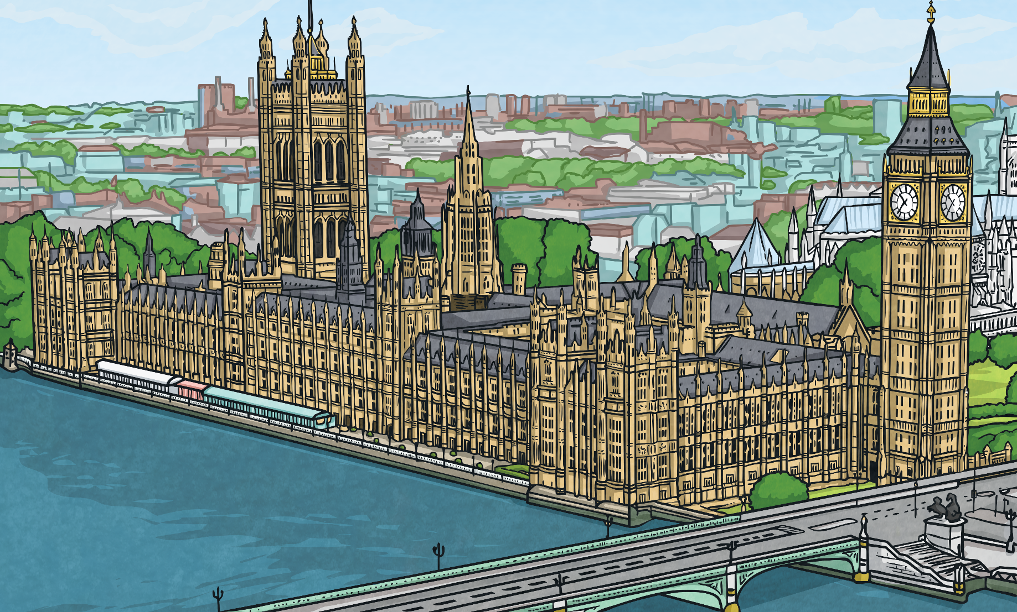
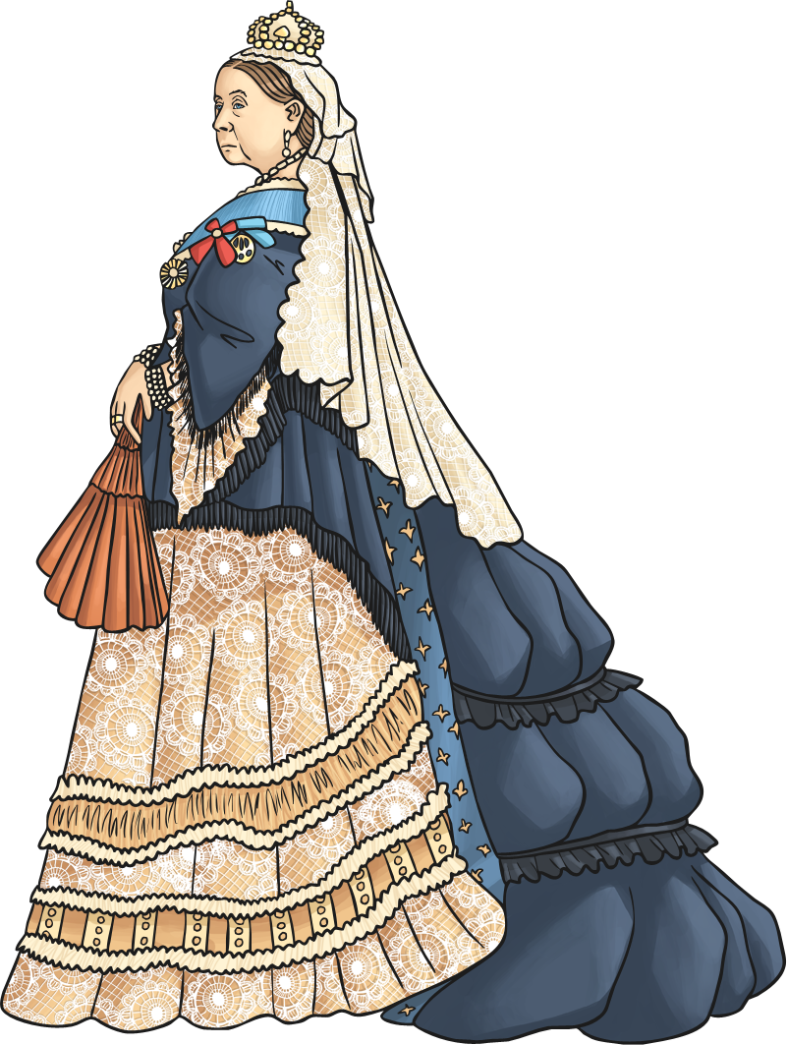
1896 to 1901
Constitution Act, 1900
Only one obstacle stood in the way now: the British Parliament.
For Australia to become a nation, the British Parliament had to agree to the Commonwealth of Australia Constitution Act. This would allow the six colonies to finally federate.
With great excitement, the Constitution Act was passed on 5th July 1900. It was one of the final acts of parliament under the long reign of Queen Victoria. She died six months later.
But what about Western Australia?
Well, faced with the reality that the rest of the colonies would soon unite as a new nation, the people of Western Australia voted overwhelmingly to join the Federation!
In March 1900, a group of delegates sailed from Australia to London to present the constitution to the British Parliament.

Slide 20
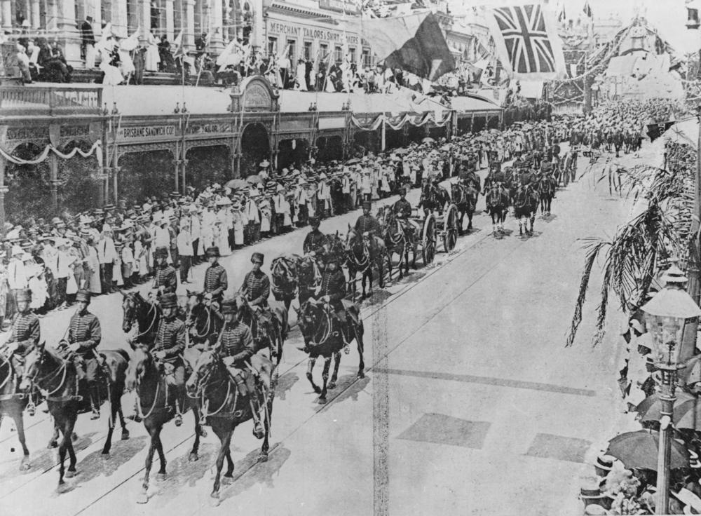
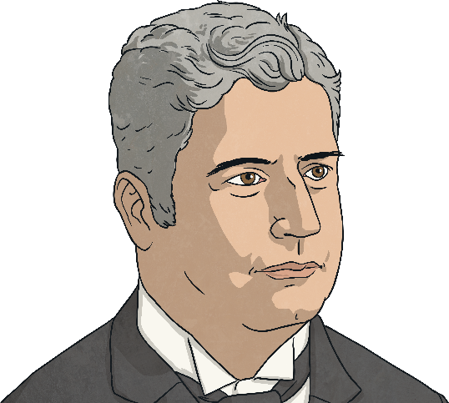
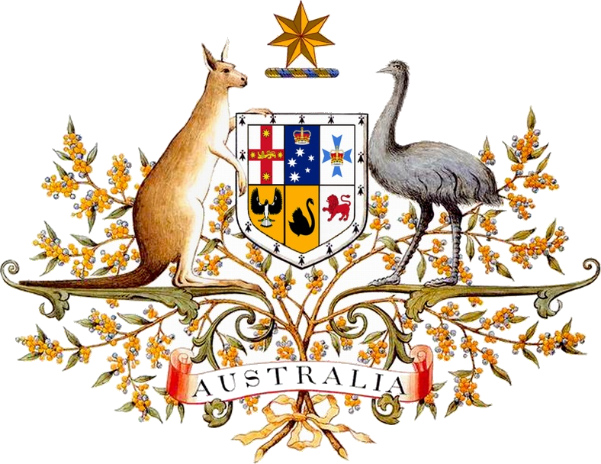
1896 to 1901
Nationhood, 1901
The ceremony was held in Centennial Park, Sydney. Australia’s first Governor General and first Prime Minister, Edmund Barton, were sworn in that day.
Across Australia, people celebrated with fireworks displays, sporting events and parades.
Click the link below to listen to Edmund Barton’s story.
100 000 attended the ceremony and 500 000 people lined the streets to watch the Federation parade pass by.
On 1st January 1901, the six colonies of Australia federated to become states of the Commonwealth of Australia.

Slide 21
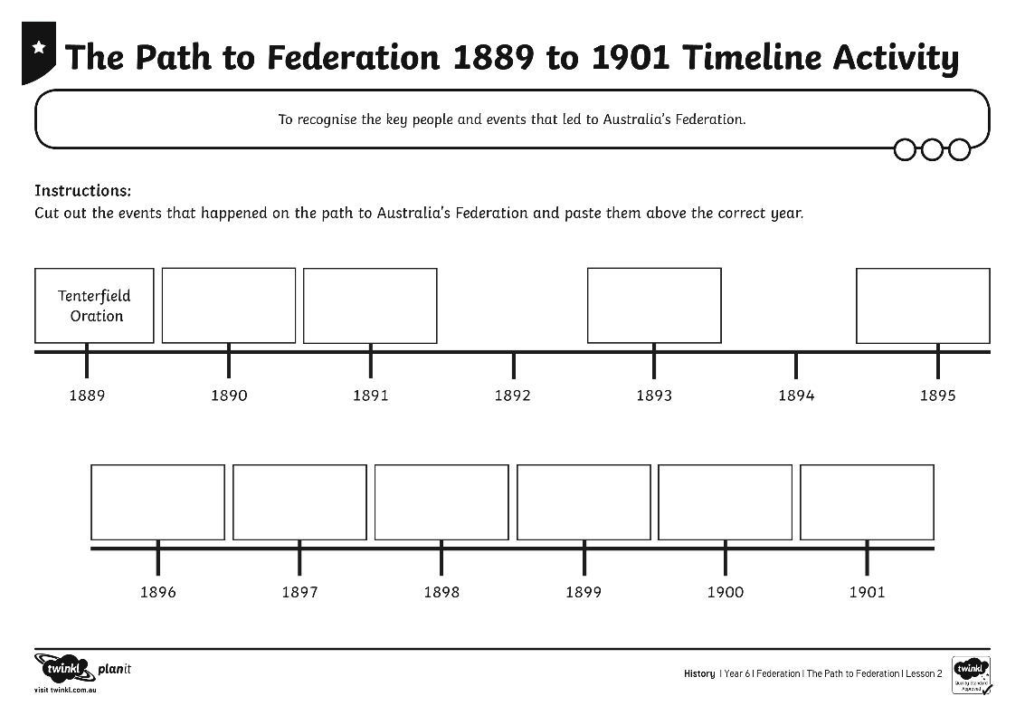
Timeline
Let’s consolidate what we have learnt about the path to Australia’s Federation.
On your own, complete The Path to Federation 1889 to 1901 Timeline Activity Sheet.

Slide 22
Aim
To recognise the key people and events that led to Australia’s Federation.
Success Criteria
I can identify the key people who led the drive towards Australia’s Federation.
I can discuss how economic depression affected the drive towards Federation.
I can order the key events that led to Australia’s Federation on a timeline.
I can explain when and how Federation finally happened.

Slide 23


